Slide 1
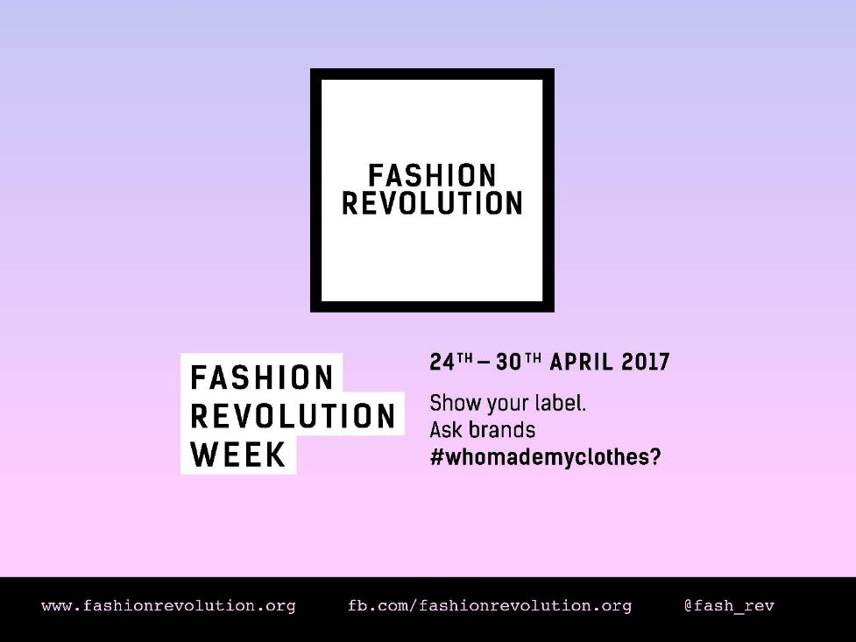
Notes:
Fashion Revolution is a movement which wants to make the clothing industry fairer for everyone involved.
This Powerpoint is an introduction to Fashion Revolution and its key messages for you to use in the classroom and is useful as a starting point for any other Fashion Revolution educational resources. We have provided accompanying notes but feel free to adapt them to your own requirements.

Slide 2
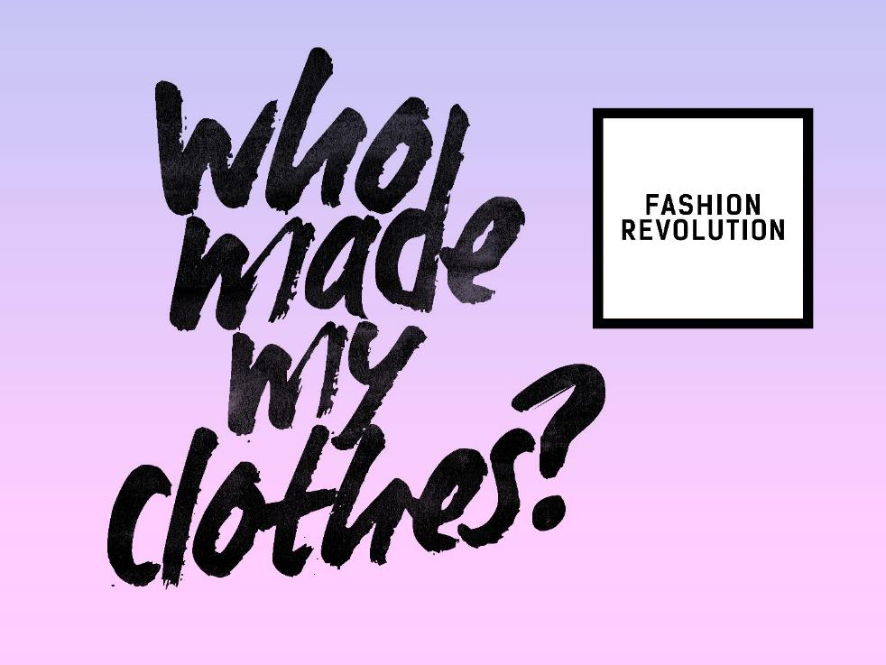
Notes:
The core theme is asking the question ‘who made my clothes’ and helping us all to understand more about the lives of the people who make our clothes.

Slide 3
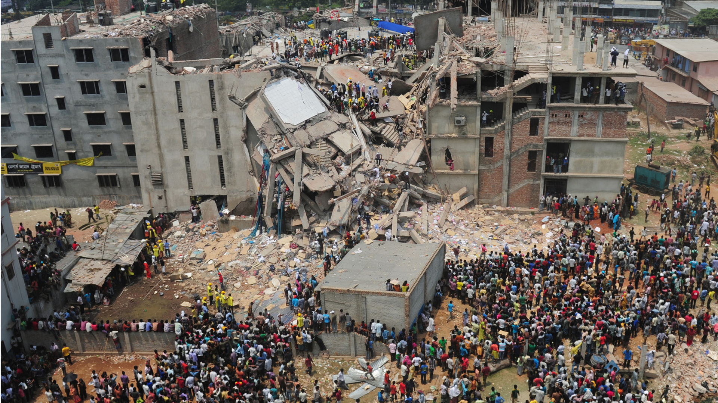
Notes:
On 24 April 2013 a garment factory in the Rana Plaza complex in Bangladesh collapsed. There were five garment factories in Rana Plaza all manufacturing clothing for the western market. The victims were mostly young women.

Slide 4
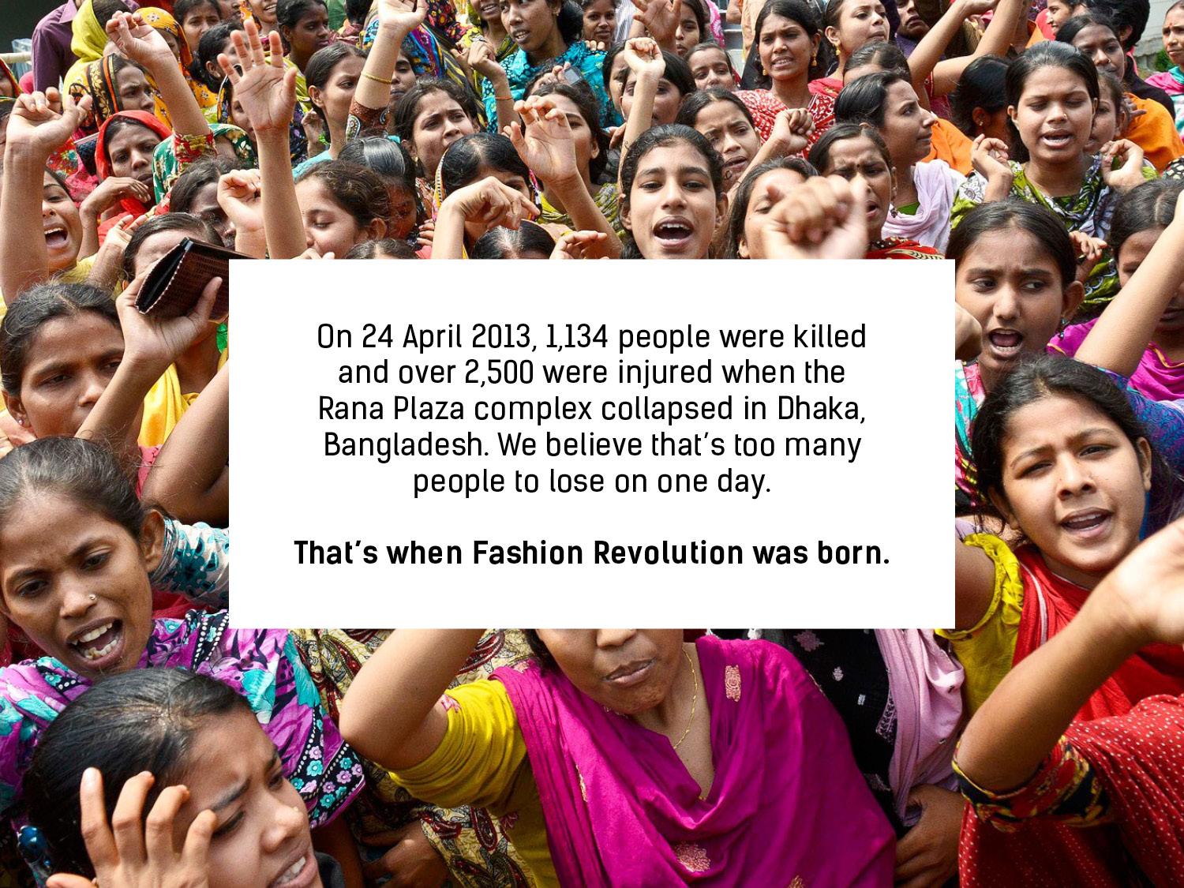
On 24 April 2013, 1,138 people were killed and over 2,500 were injured when the Rana Plaza complex collapsed in Dhaka, Bangladesh. We believe that’s too many people to lose on one day.
That’s when Fashion Revolution was born.
Notes:
Since then people from all over the world have come together to use the power of fashion to change the world. Fashion Revolution is now a global movement of people like you.

Slide 5
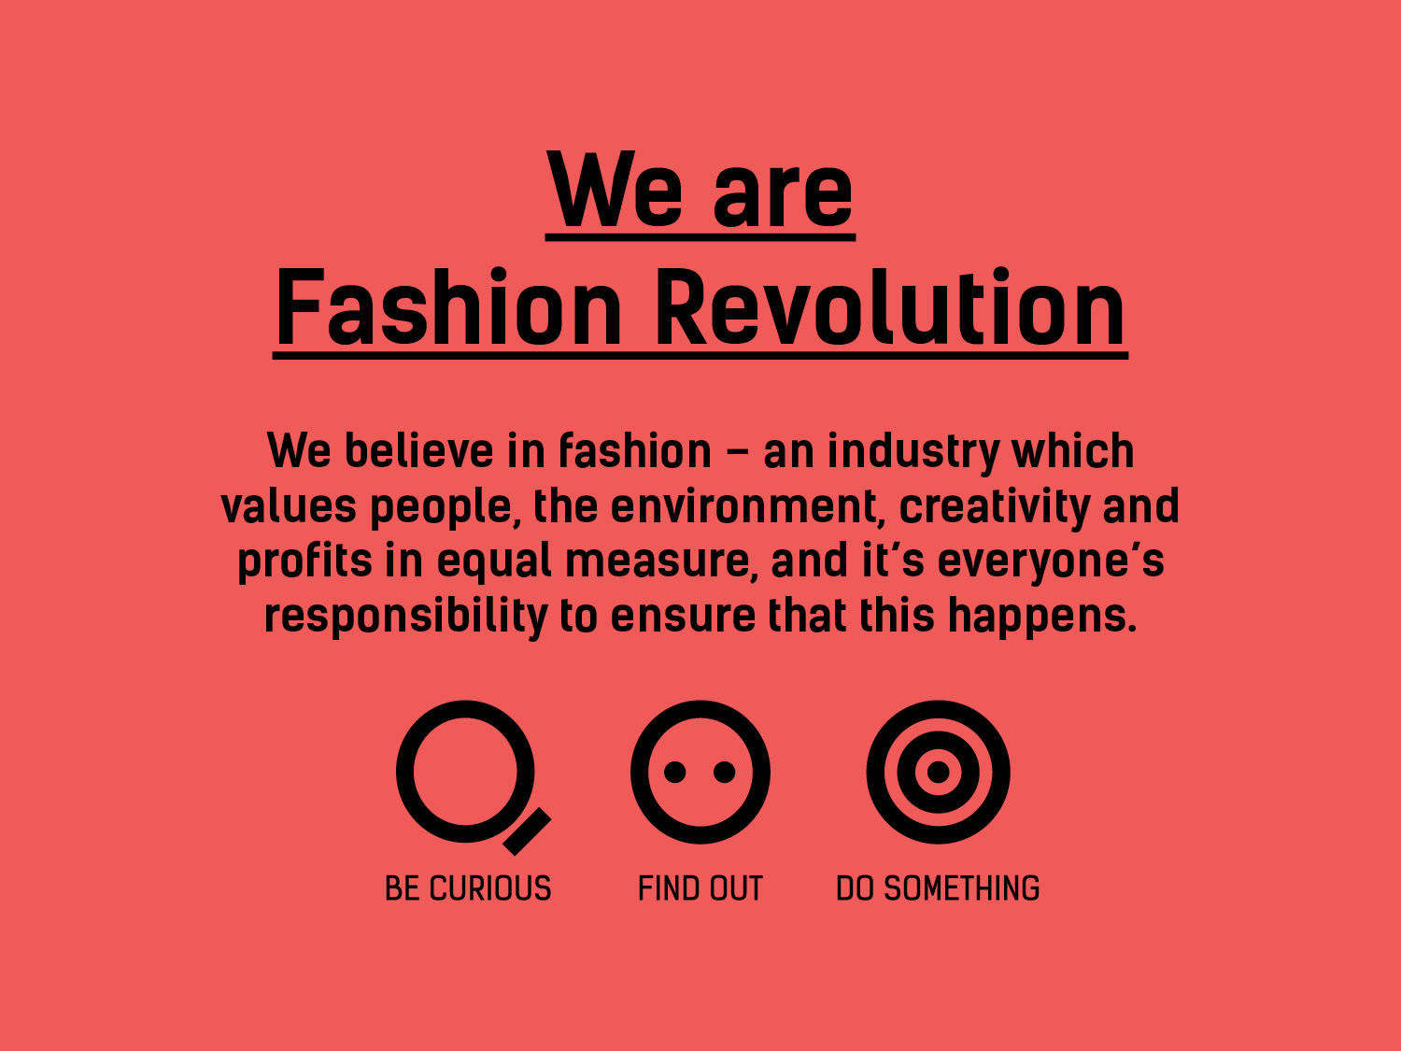
Notes:
Fashion Revolution is a global movement that wants to change the way the fashion industry works.
It invites designers, academics, writers, ^{business leaders,} ^{policymakers, brands,} ^{retailers, marketers,} ^{producers, makers,} workers and fashion lovers to be involved.
Fashion Revolution believes that positive change can happen if we all think differently about fashion and demand better. It campaigns for a cleaner, safer, fairer, more transparent and more accountable fashion and textiles industry.
It wants fashion to become a force for good – an industry that values people, the environment, creativity and profit in equal measure.

Slide 6
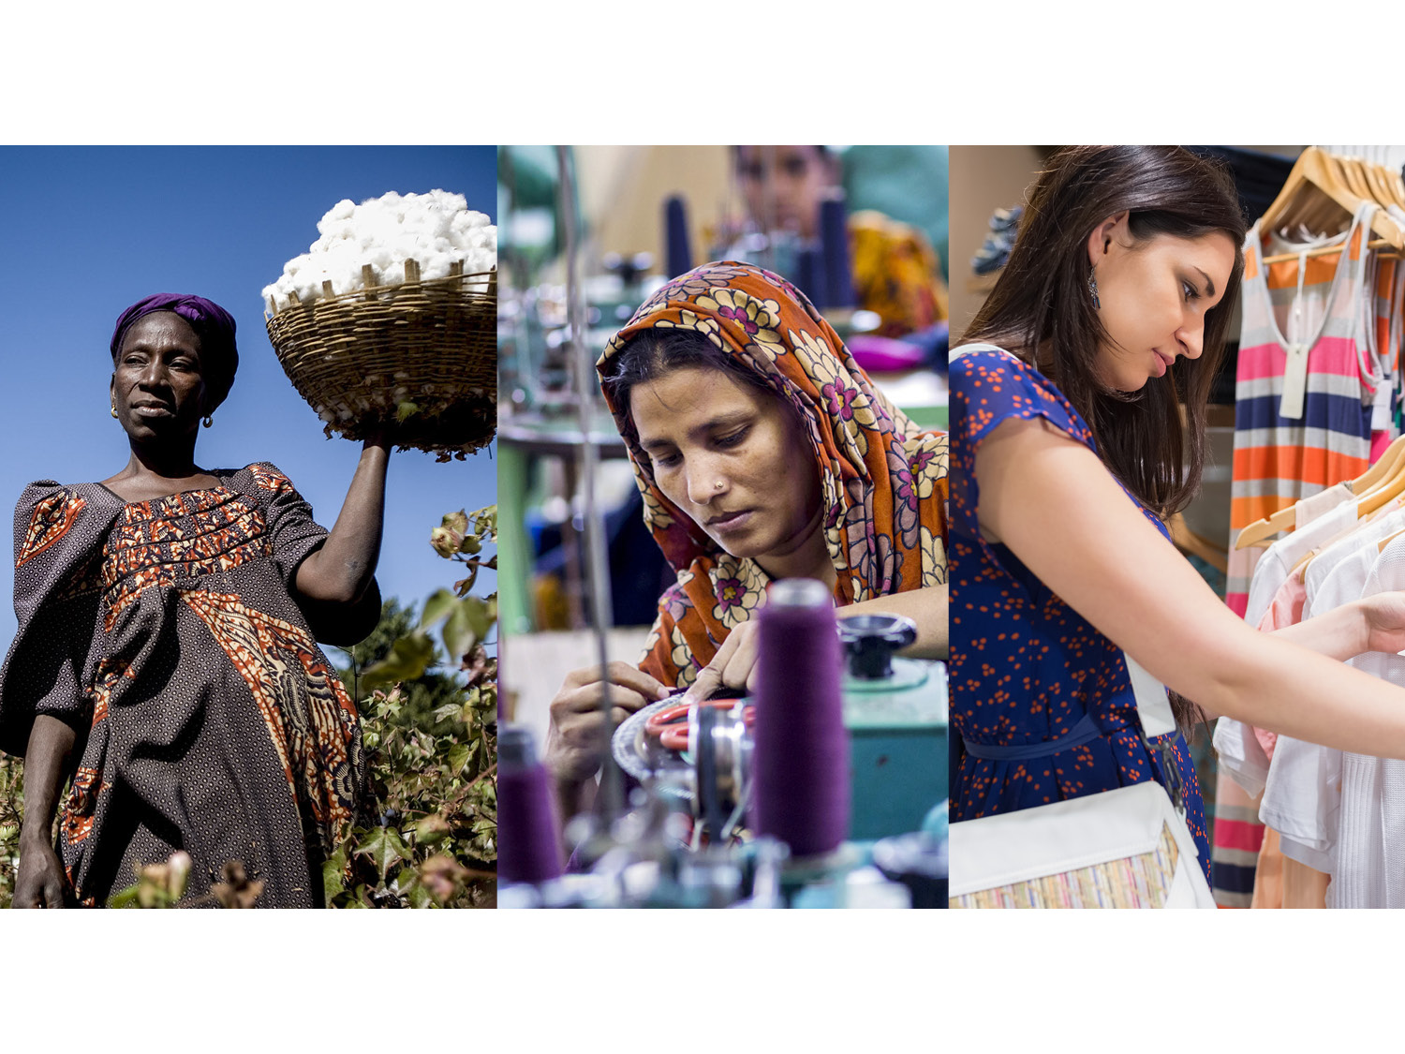
Notes:
Millions of people work in the fashion industry. We believe the industry can and should work better for all of them.

Slide 7
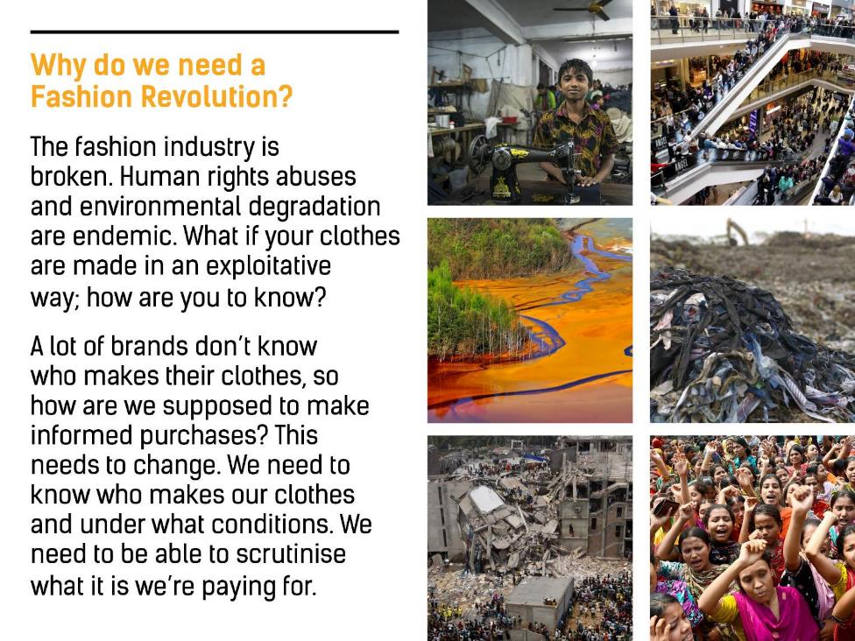
Notes:
The fashion industry is broken. Human rights abuses and environmental degradation are endemic. What if your clothes are made in an exploitative way; how are you to know?
A lot of brands don’t know who makes their clothes, so how are we supposed to make informed purchases? This needs to change. We need to know who makes our clothes and under what conditions. We need to be able to scrutinise what it is we’re paying for.

Slide 8
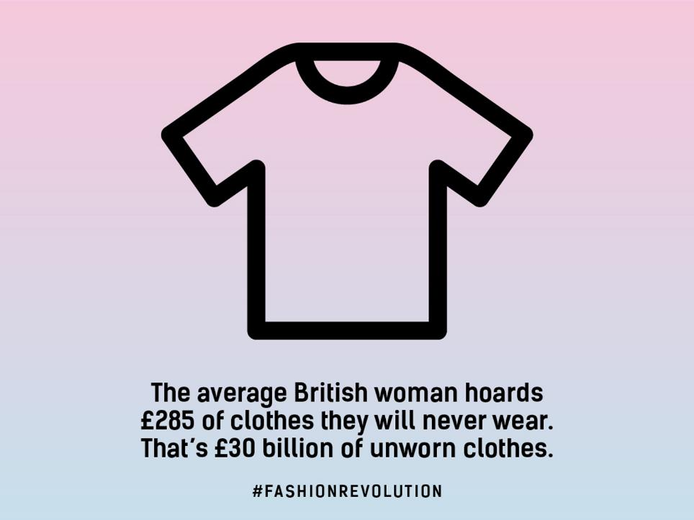
Notes:
Lots of people buy clothes that they never end up wearing.

Slide 9
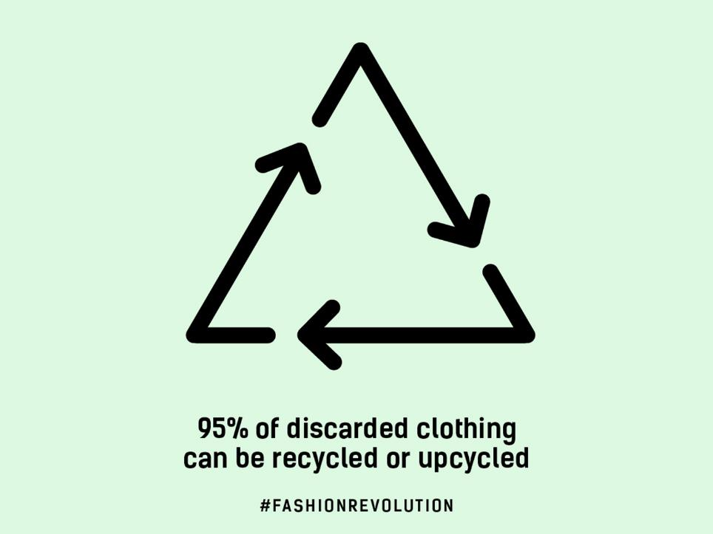
Notes:
http://www.tedresearch.net/media/files/Recycling.Upcycling.pdf

Slide 10
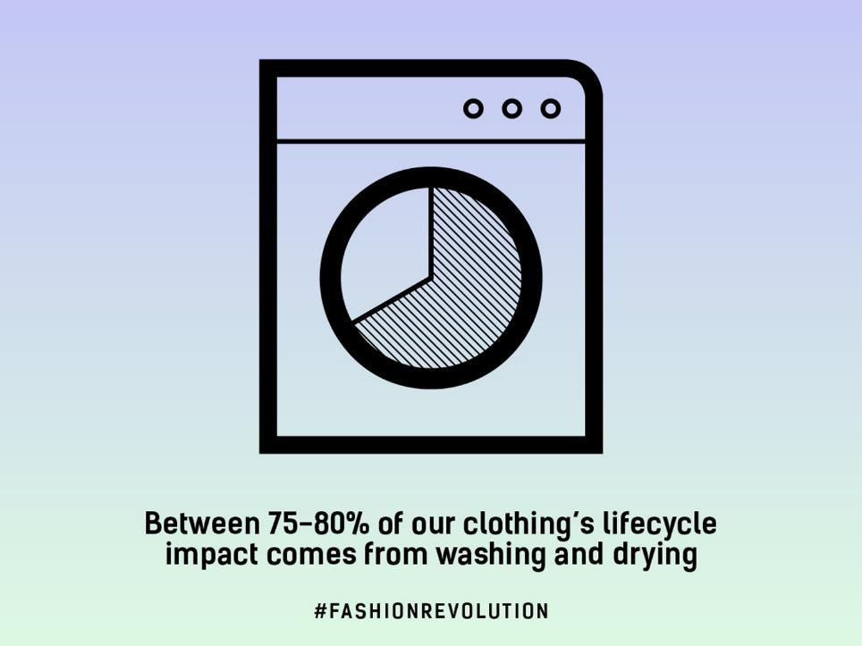
Notes:
Washing and drying your clothes is a big part of their environmental impact.

Slide 11
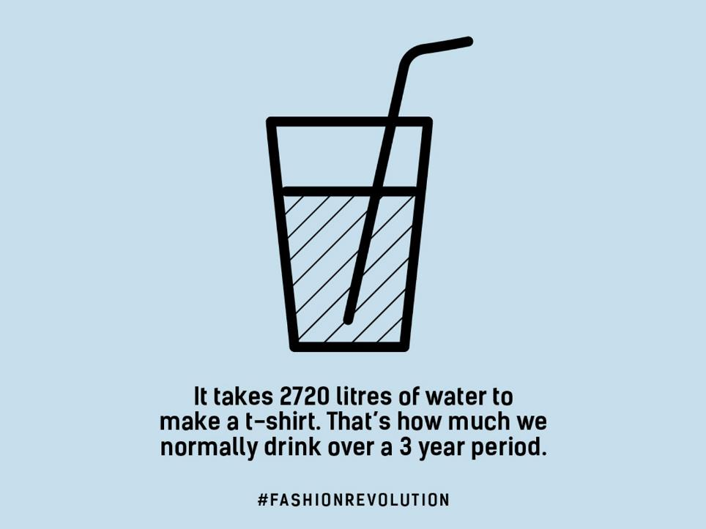
Notes:
A huge amount of water is used in the production of one t-shirt.
Via WWF
http://www.worldwildlife.org/stories/the-impact-of-a-cotton-t-shirt

Slide 12
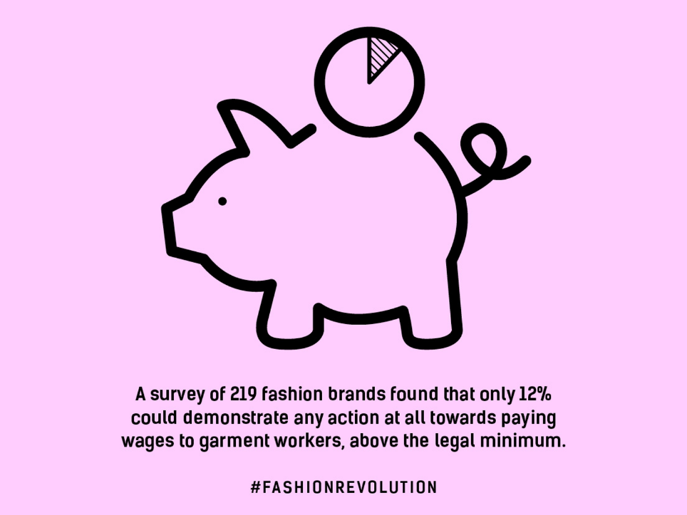
Notes:
The Baptist World Report has a lot of data about the fashion industry https://baptistworldaid.org.au/resources/2016-australian-fashion-report/

Slide 13
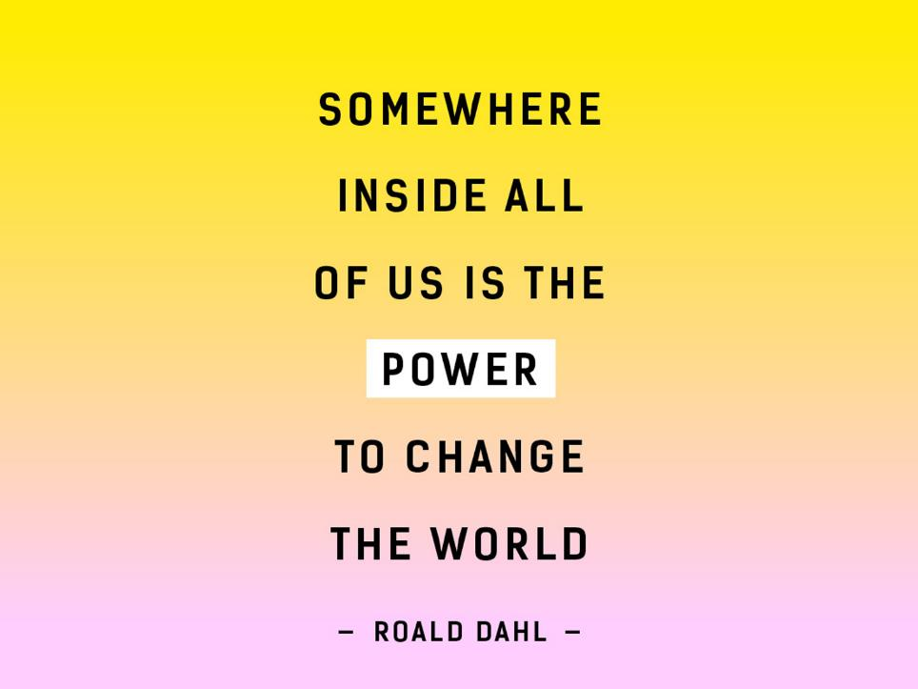
Notes:
This is a great quote by author Roald Dahl which encourages us all to take action to catalyse change.

Slide 14
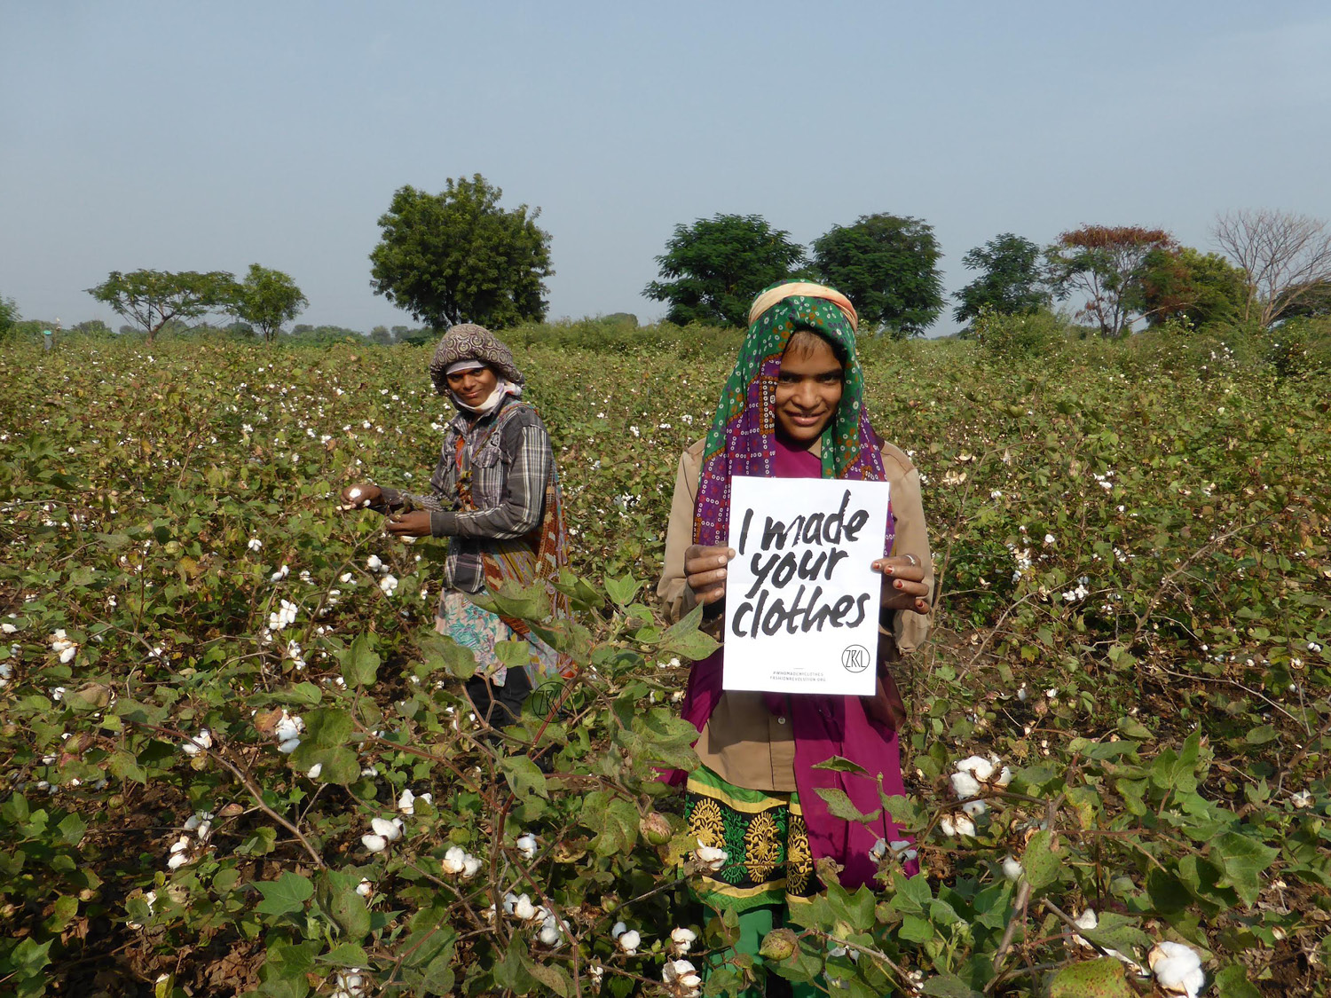
Notes:
Every year people all over the world get involved in Fashion Revolution Week, like these cotton farmers in Kasrawad, Madhya Pradesh, India. Origin of the ZRCL Cotton

Slide 15
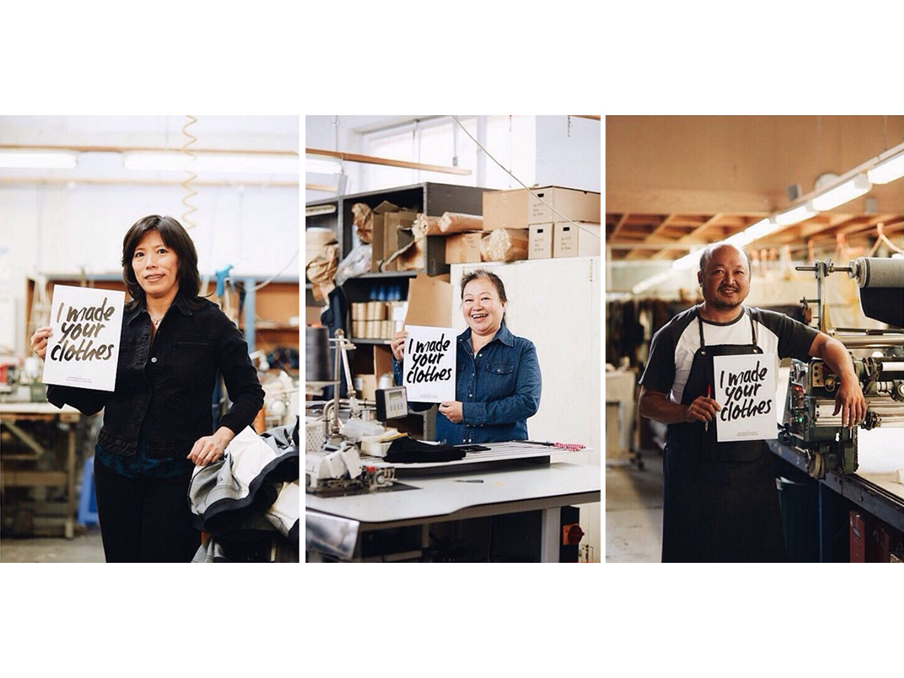
Notes:
We can actually see the faces of the people who make our clothes – something a lot of us do not think about.

Slide 16
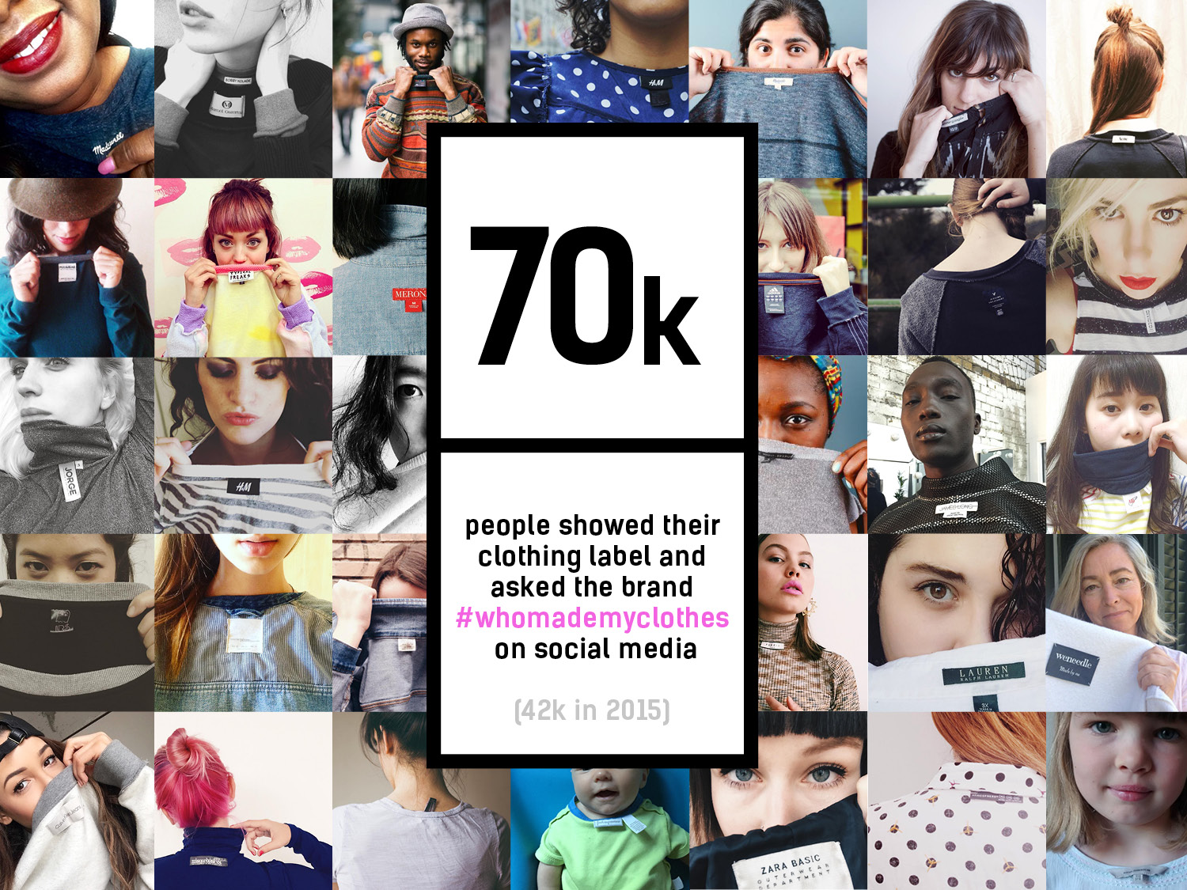
Notes:
Citizens all over the world show the label inside their clothes and ask brands on social media who made my clothes?

Slide 17
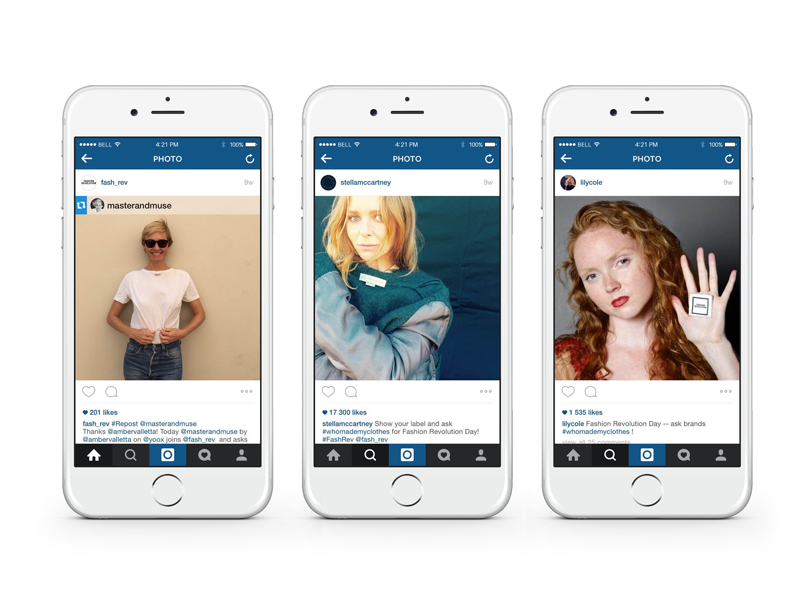
Notes:
Many celebrities get involved

Slide 18
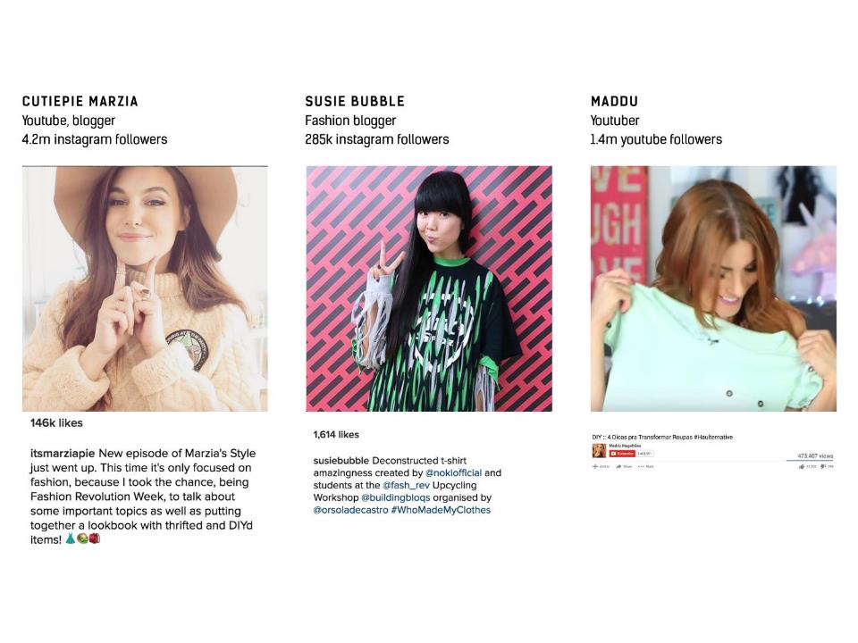
Notes:
Also online celebrities have got involved on social media.

Slide 19
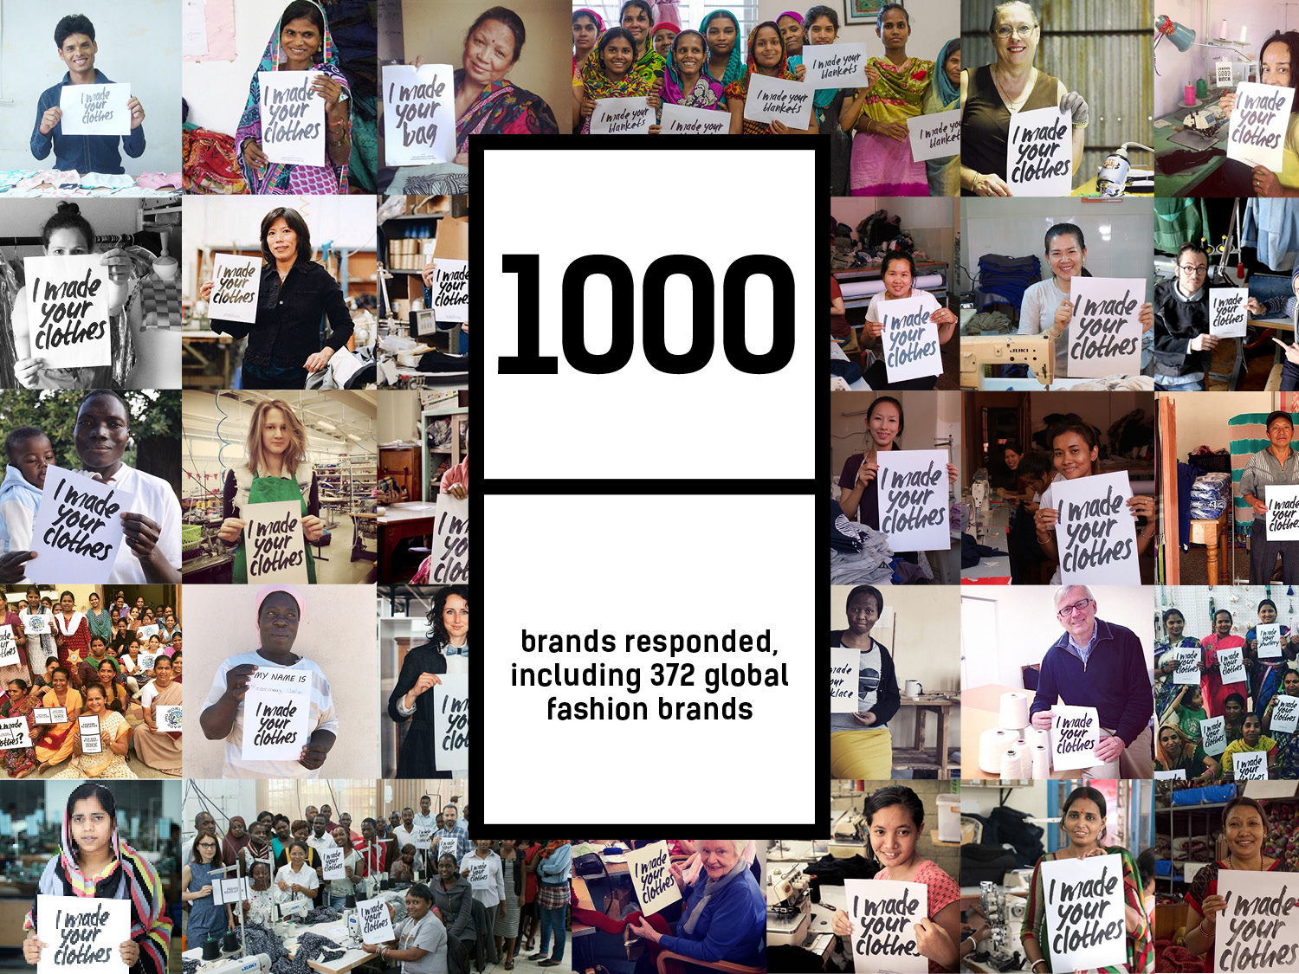
Notes:
During Fashion Revolution Week 2016 1000 brands responded to the question #whomadeclothes and over a third of those were global brands.

Slide 20
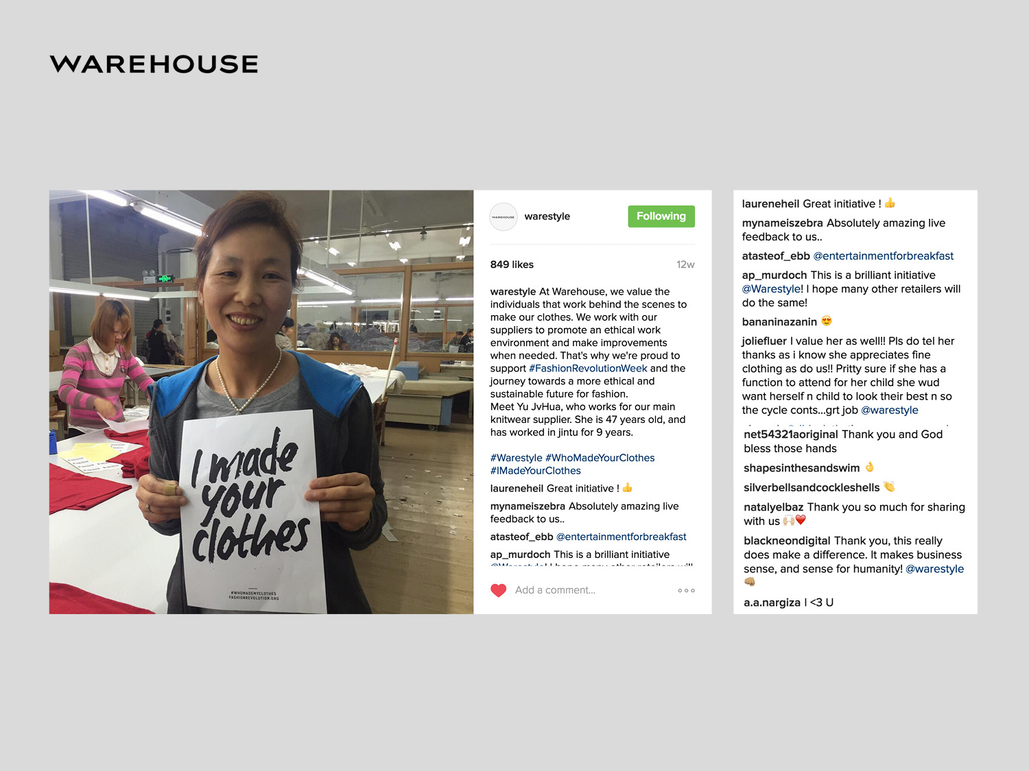
Notes:
Brands like Warehouse.

Slide 21
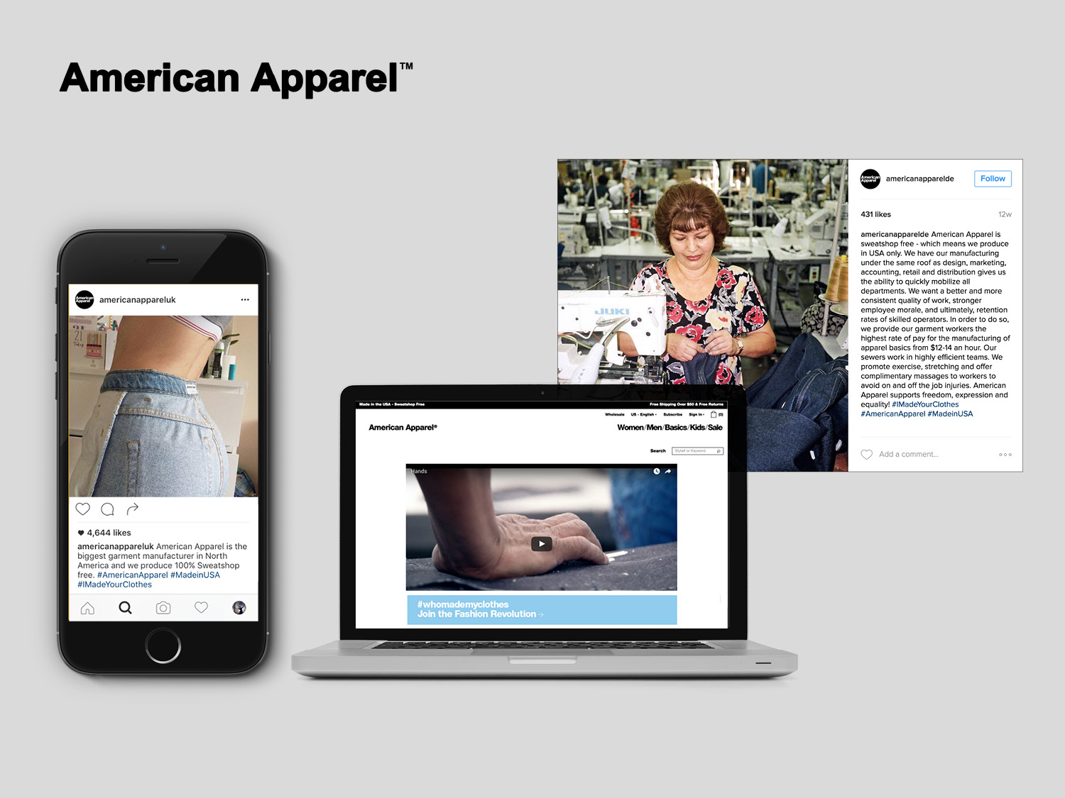
Notes:
American Apparel

Slide 22
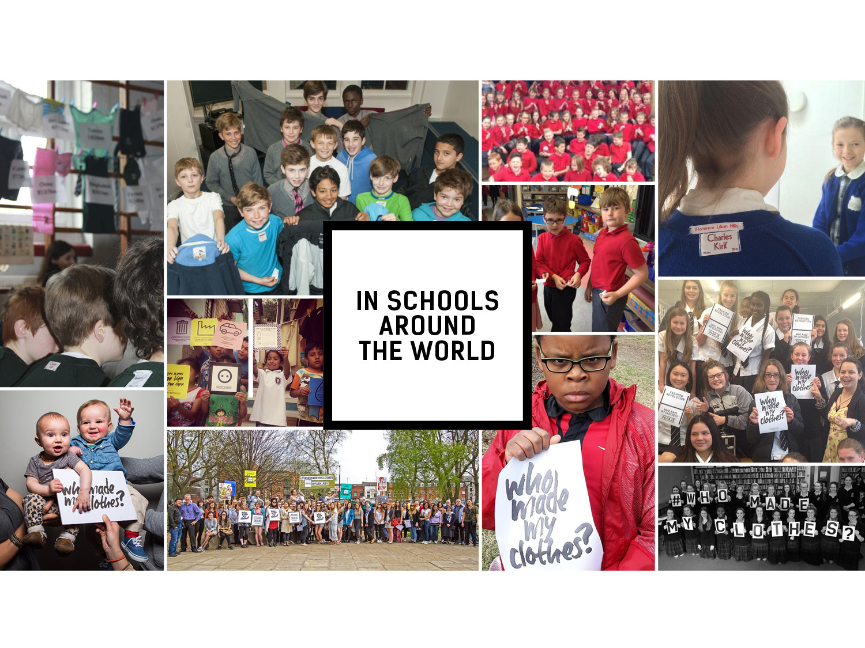
Notes:
Fashion Revolution Week is celebrated in schools and universities across the world from,primary school children right up to university level. They share their activities on social media using the hashtag #whomademyclothes. (According to the policies of each individual establishment).

Slide 23
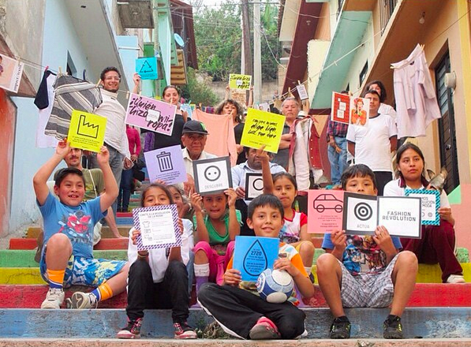
Notes:
Children can relate to the clothing industry as a great way of examining how people work and how they are treated as well as how we are affecting the environment.

Slide 24
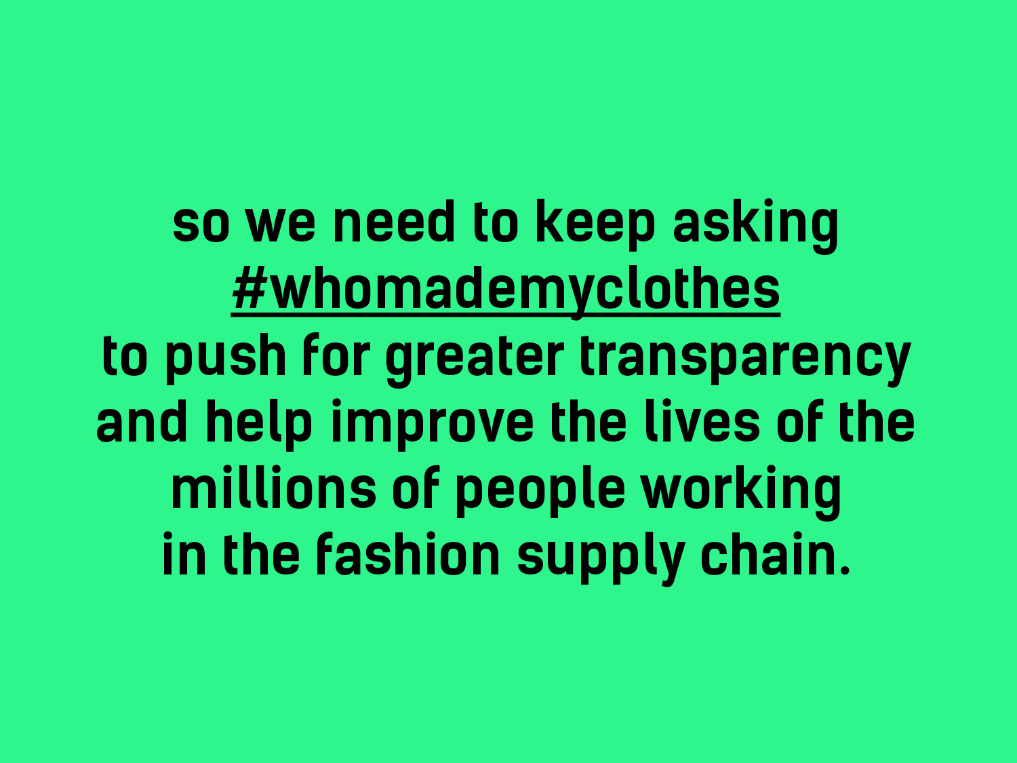
Notes:
Fashion Revolution has achieved so much but there is still a lot more to do and we can all be part of making the fashion industry a fairer place for everyone.

Slide 25
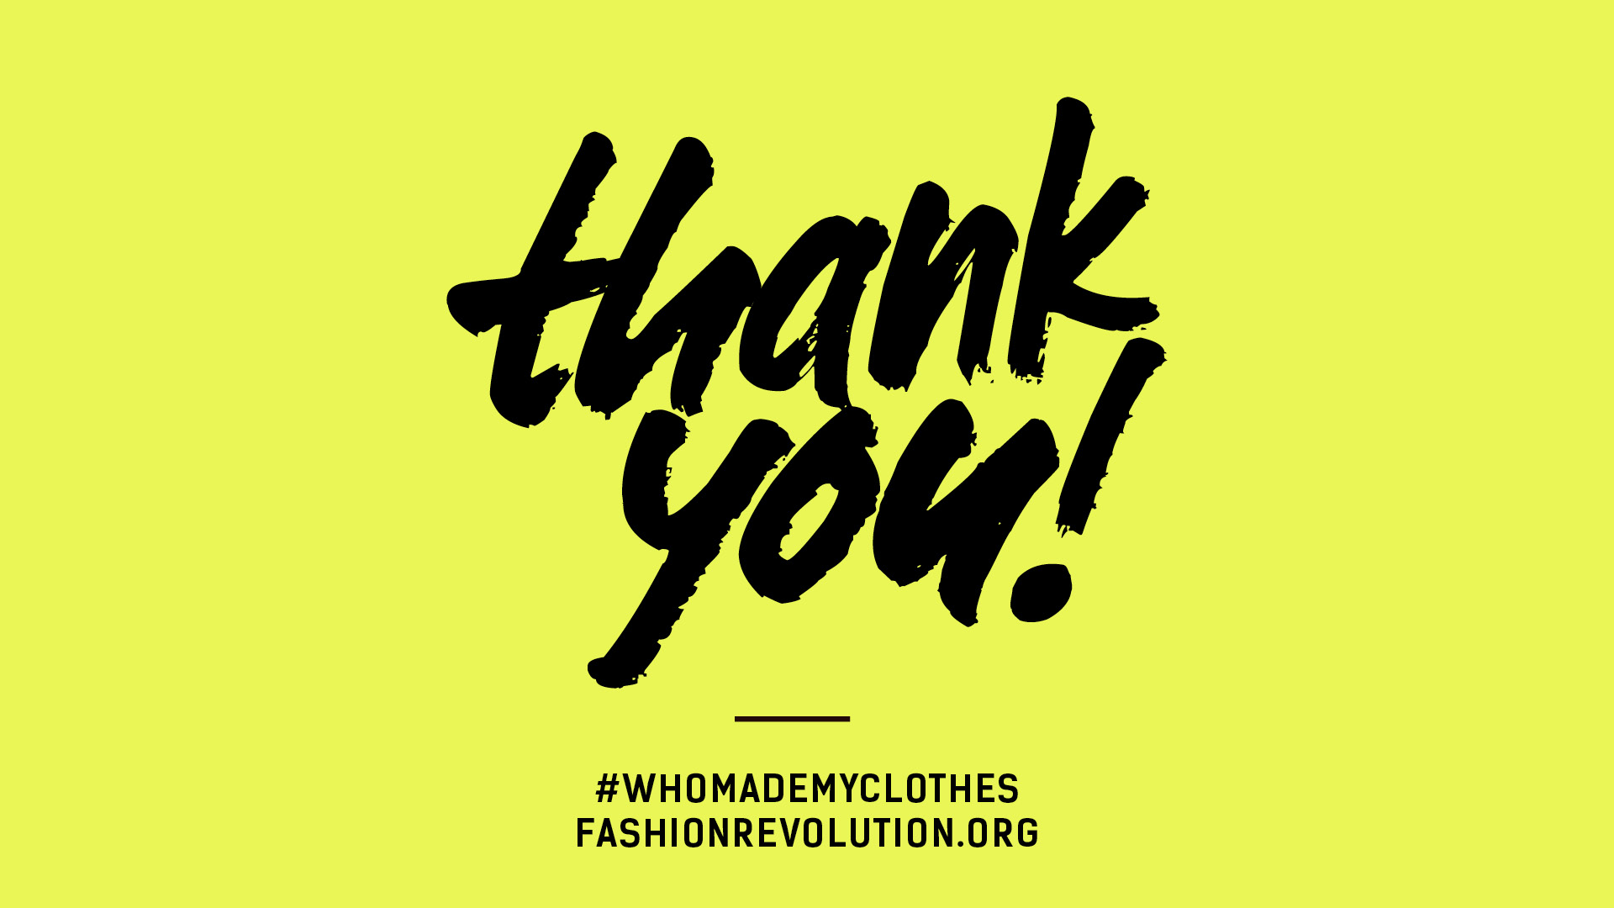
Notes:
Please do let us know about any events you do in your school! You can email education@fashionrevolution.org with details and images (please give us your permission so that we can share on our Pinterest Board https://uk.pinterest.com/fashrevglobal/education/.

